Slide 1
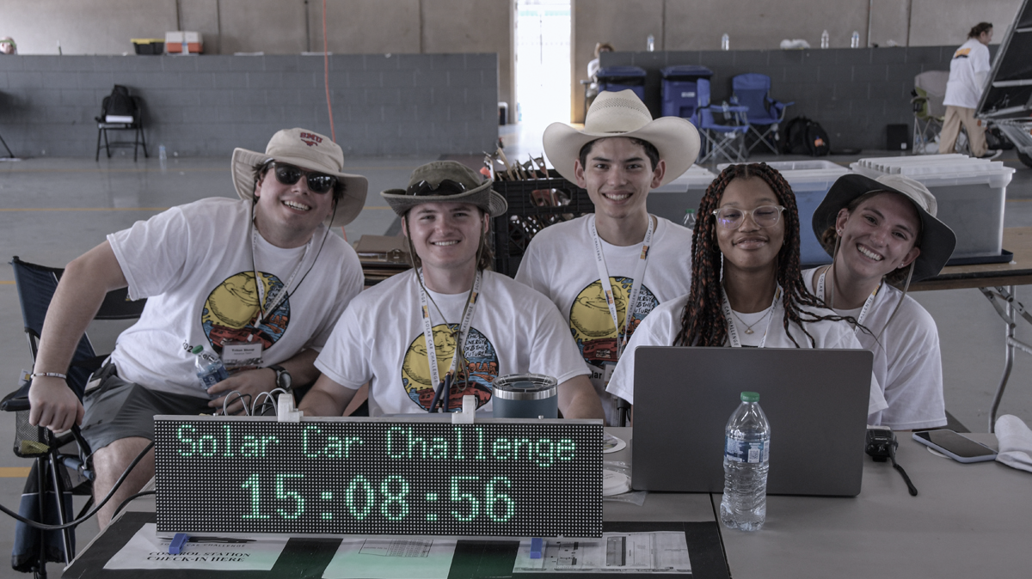
Why YOU should apply to be an Intern for the Solar Car Challenge
By: Triton Shoup – Lead Mechanical Judge

Slide 2
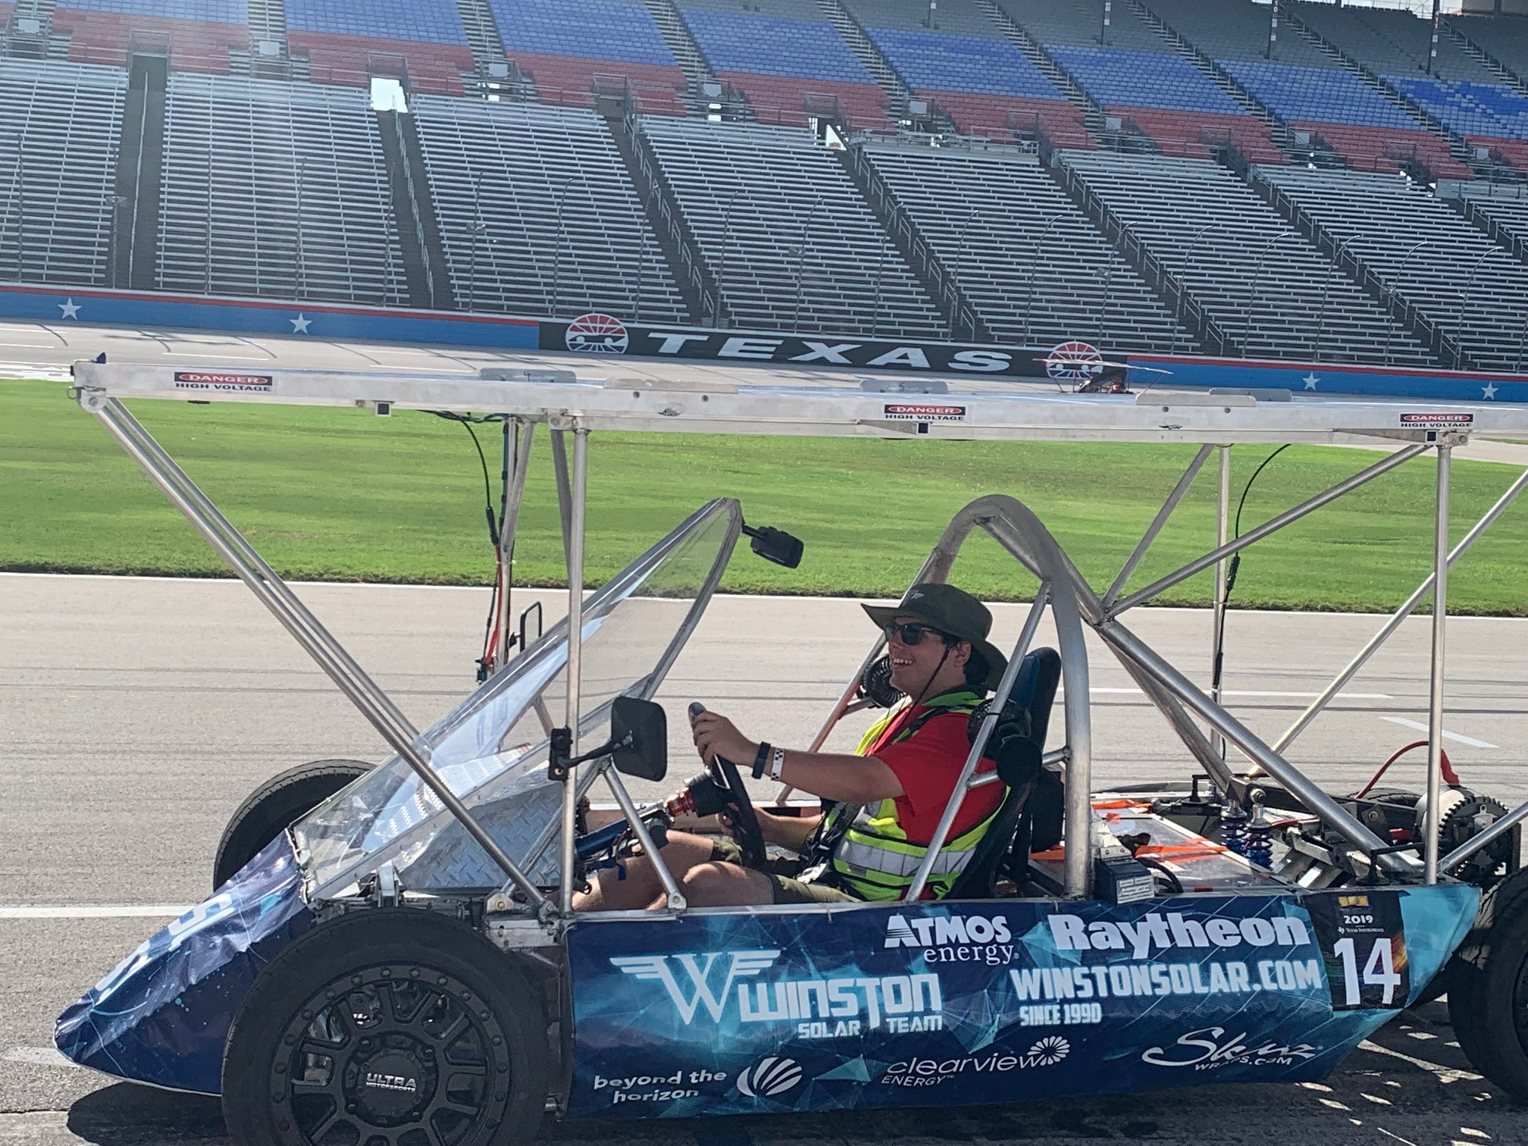
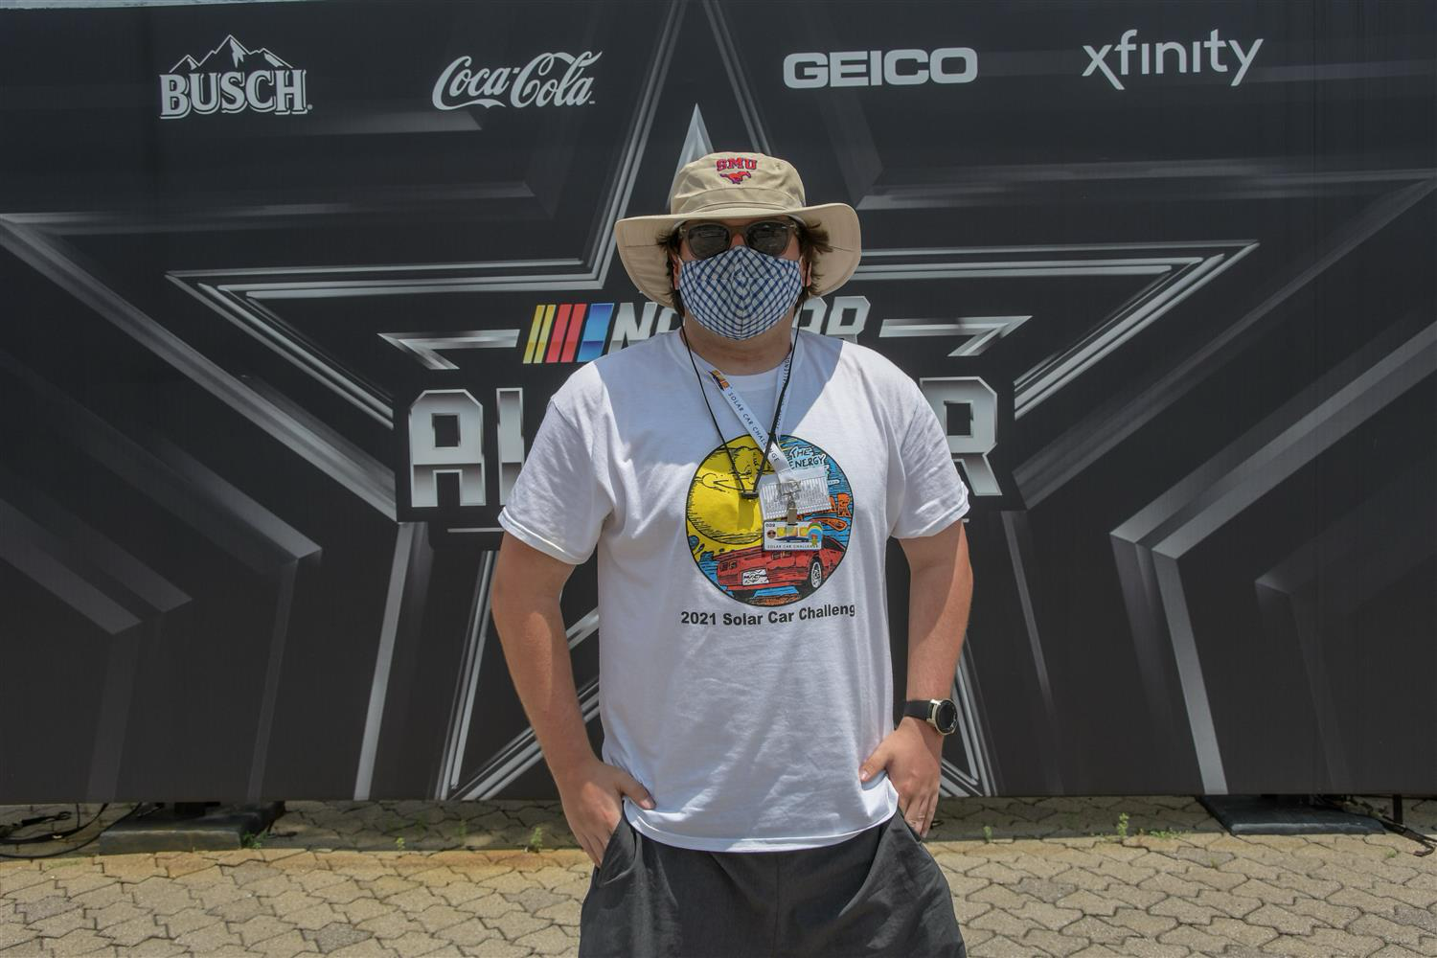
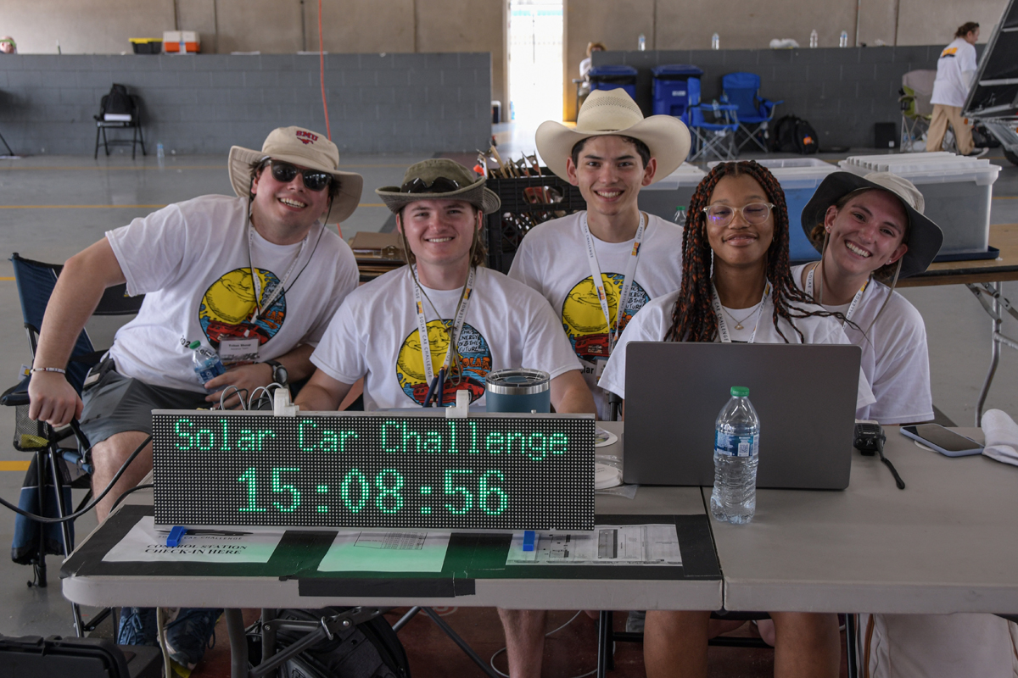
My Experience as an Intern
From Dallas, TX, Winston Solar Car Team: 2016 – 2020; Captain 2017 – 2020
Undergrad: Southern Methodist University – Mechanical Engineering
Grad: Southern Methodist University – Dual master's program in Mechanical Engineering and MBA
My time as a SCC Intern/ Staff:
  Joined 2021 – Present
  Lead Mechanical Judge: 2023 - Present
  Advance Team for the 2023 Cross-Country Race

Slide 3
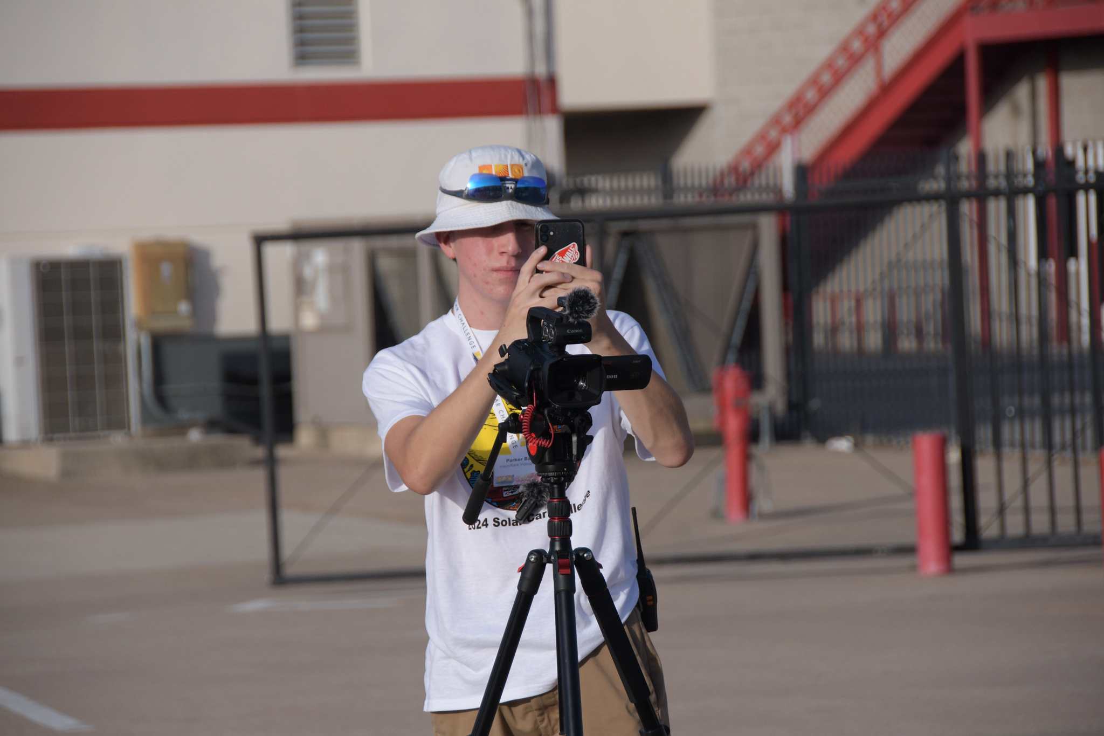
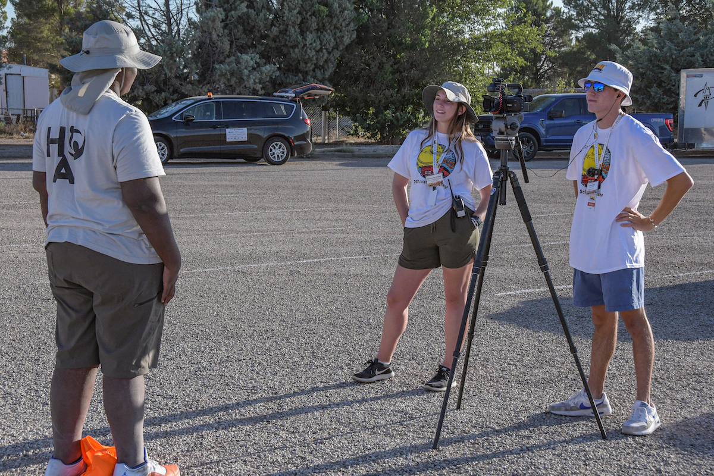
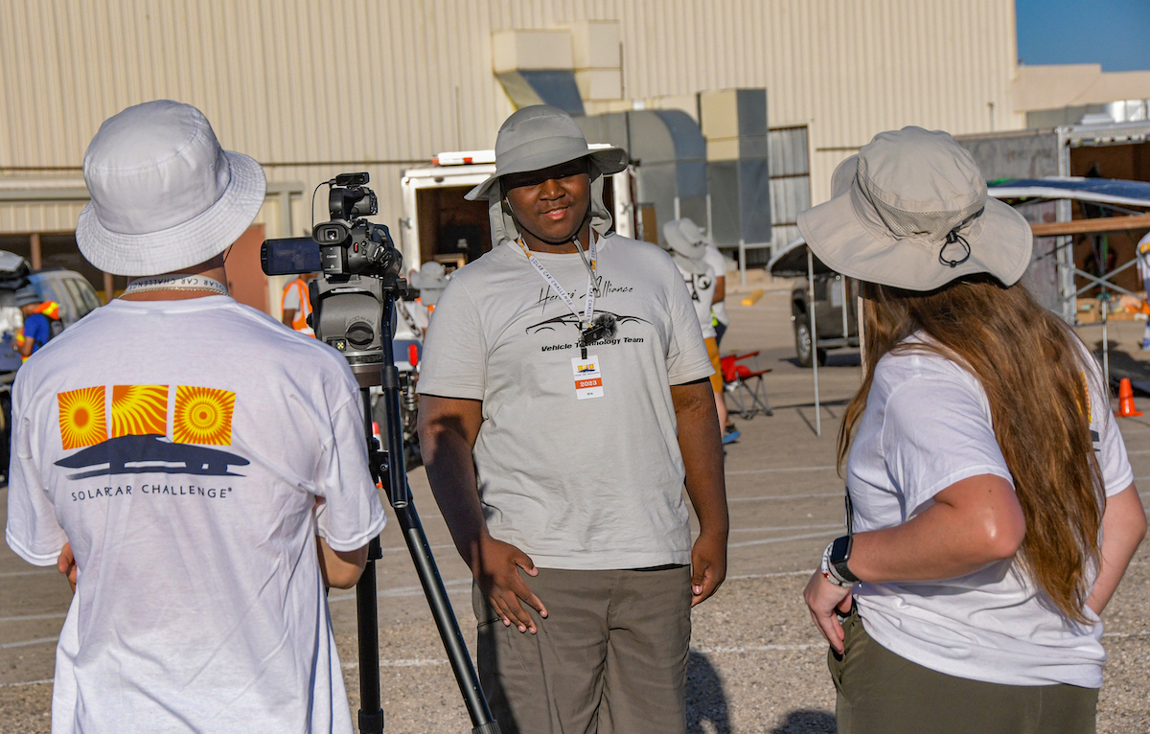
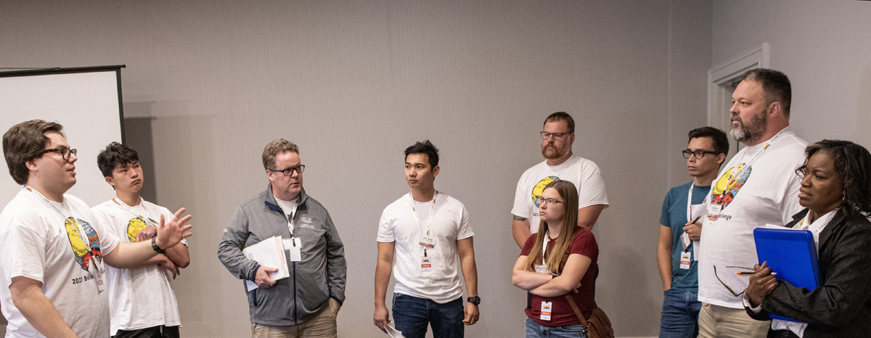
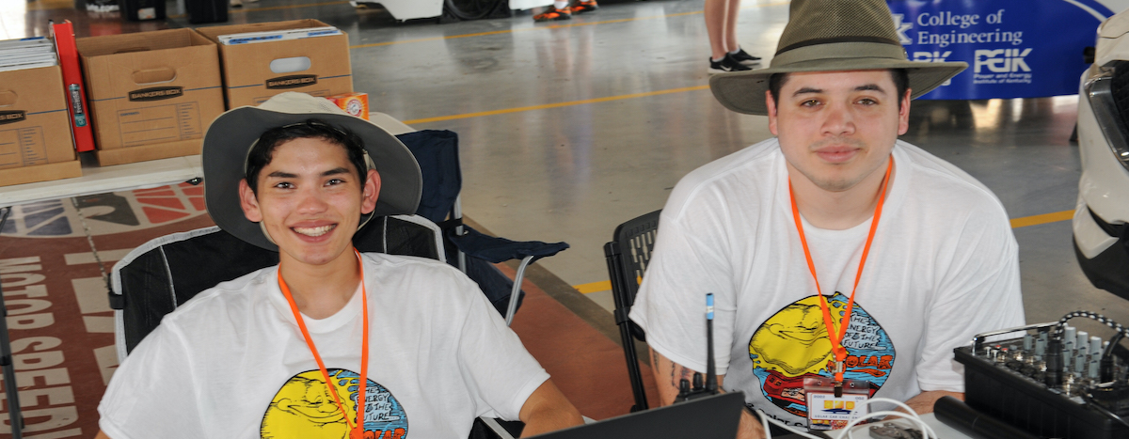
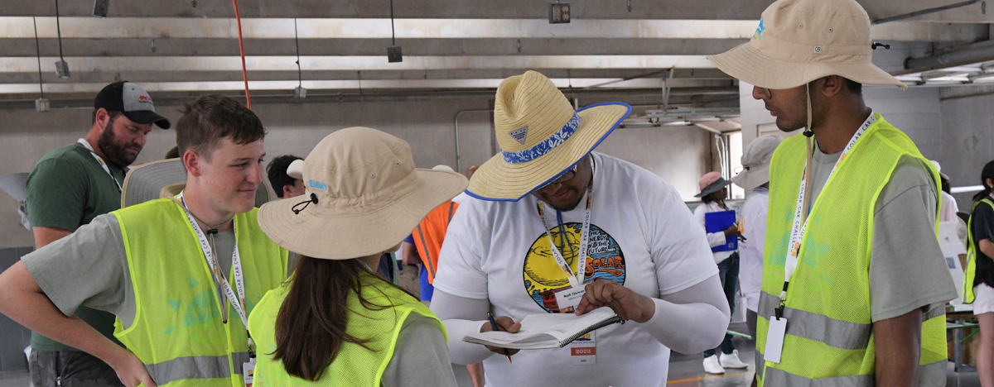
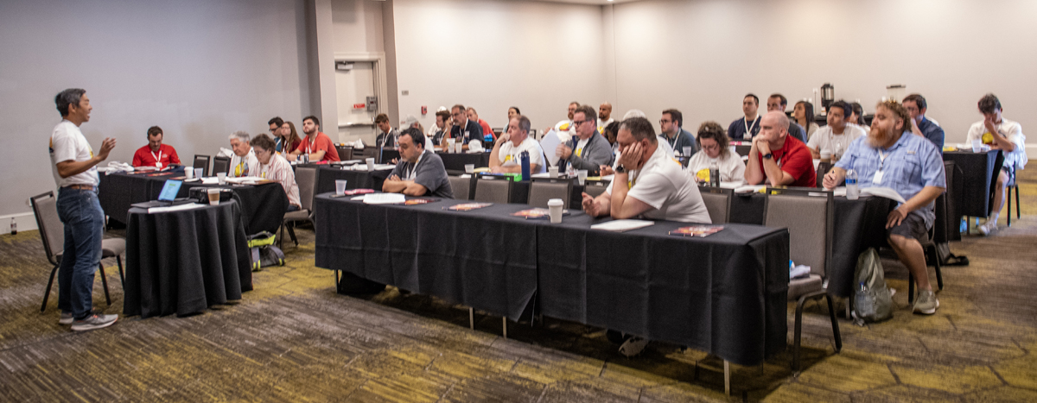
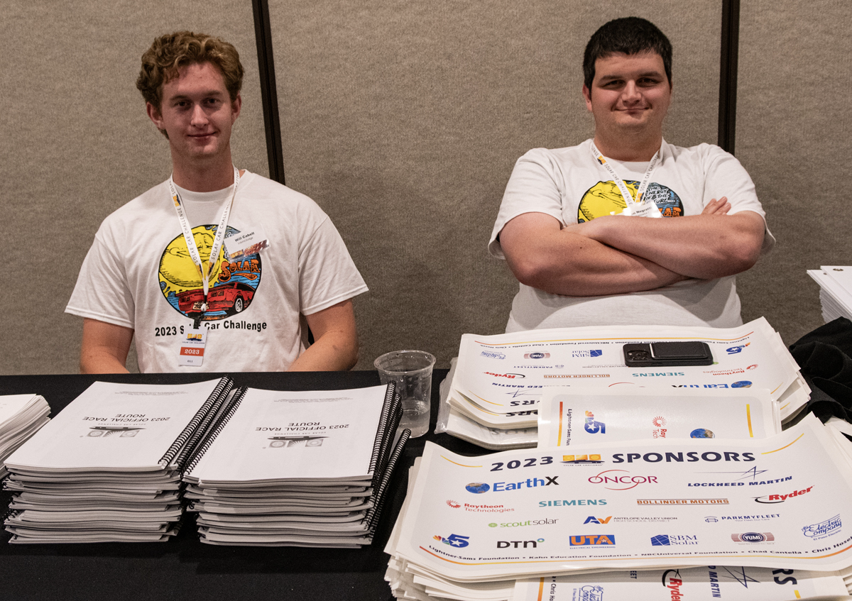
Definition: Intern
Typically, around 15 – 18 applicants are picked each year
Member of a solar car team prior to high school graduation
They are hand-selected by Dr. Marks through filled-out applications
Interns will arrive a few days before teams for training and to help set up for the coming year's race

Slide 4
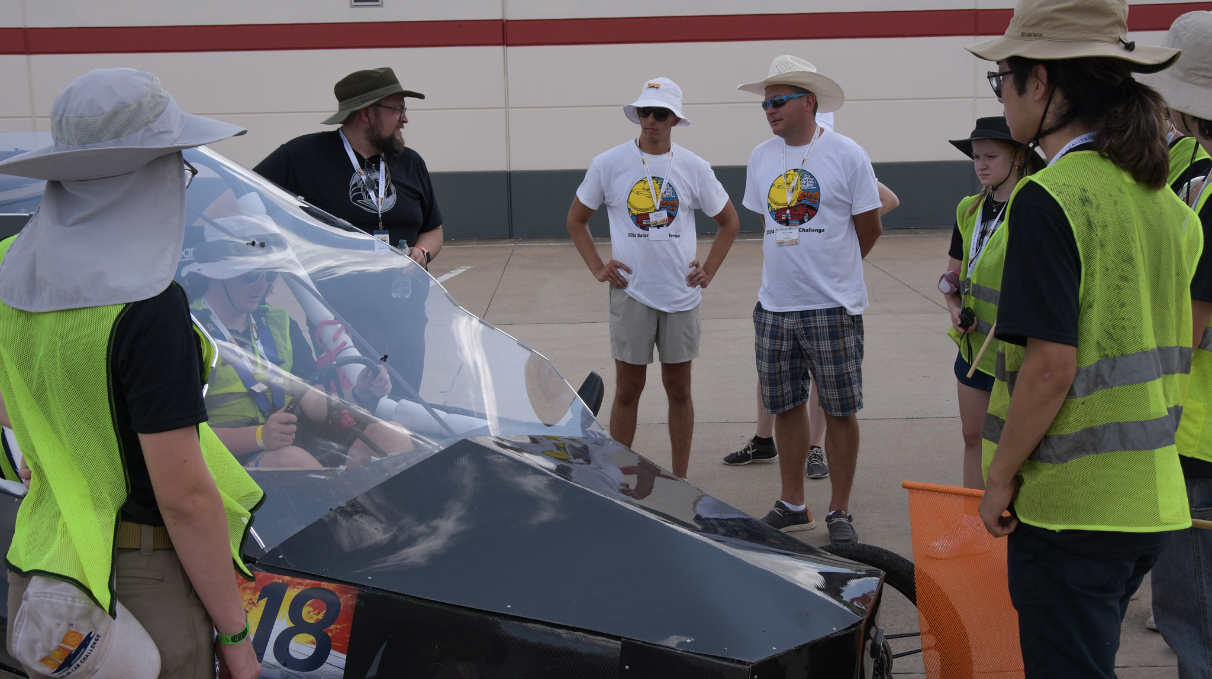
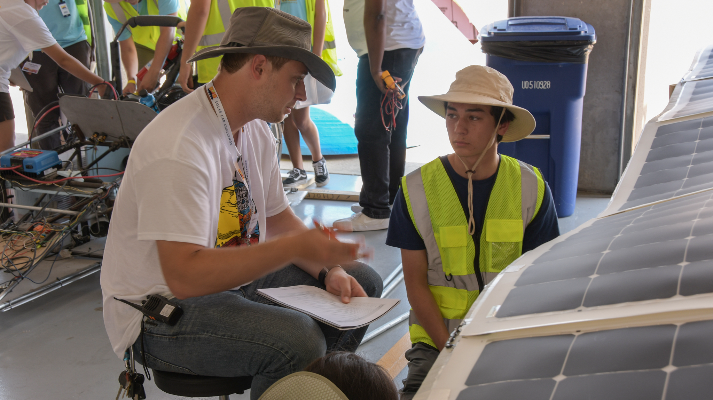
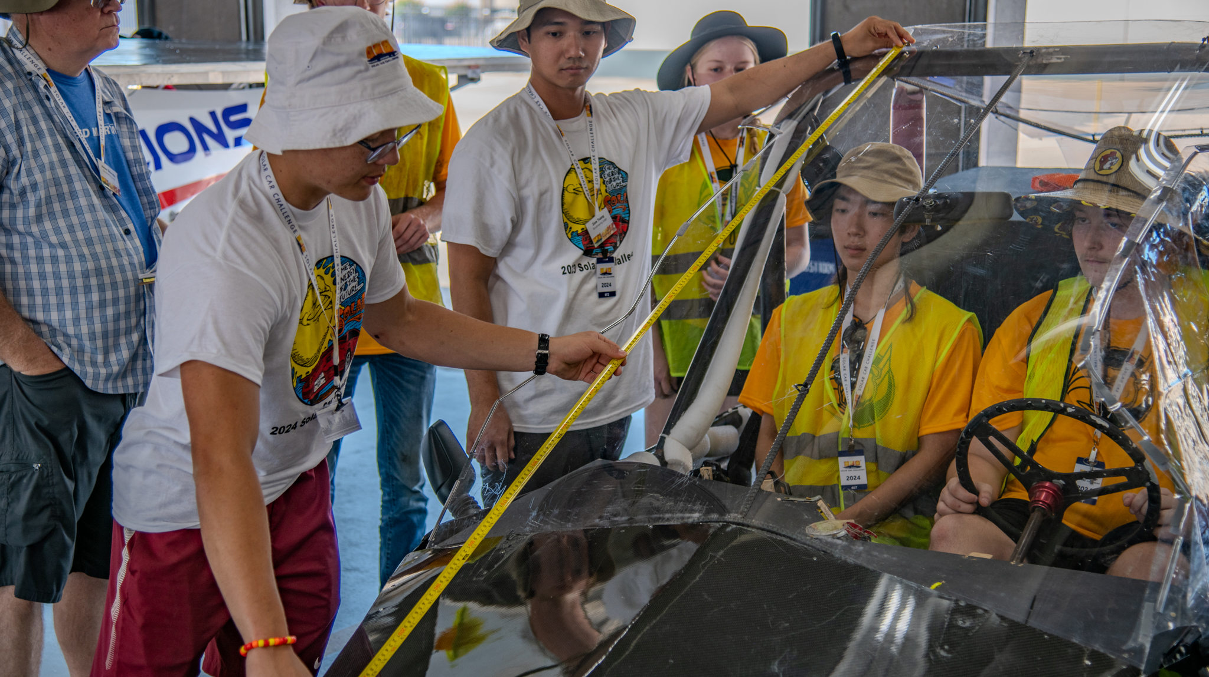
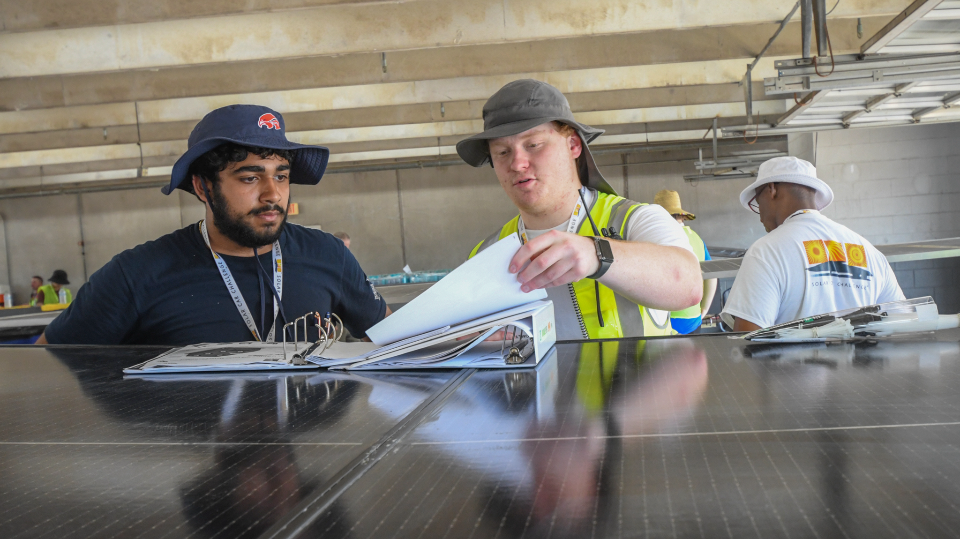
Scrutineering

Slide 5
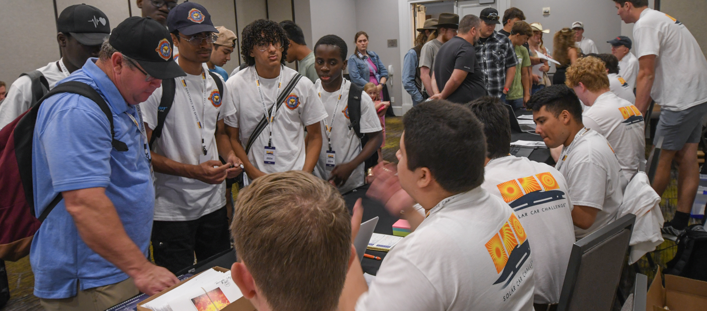
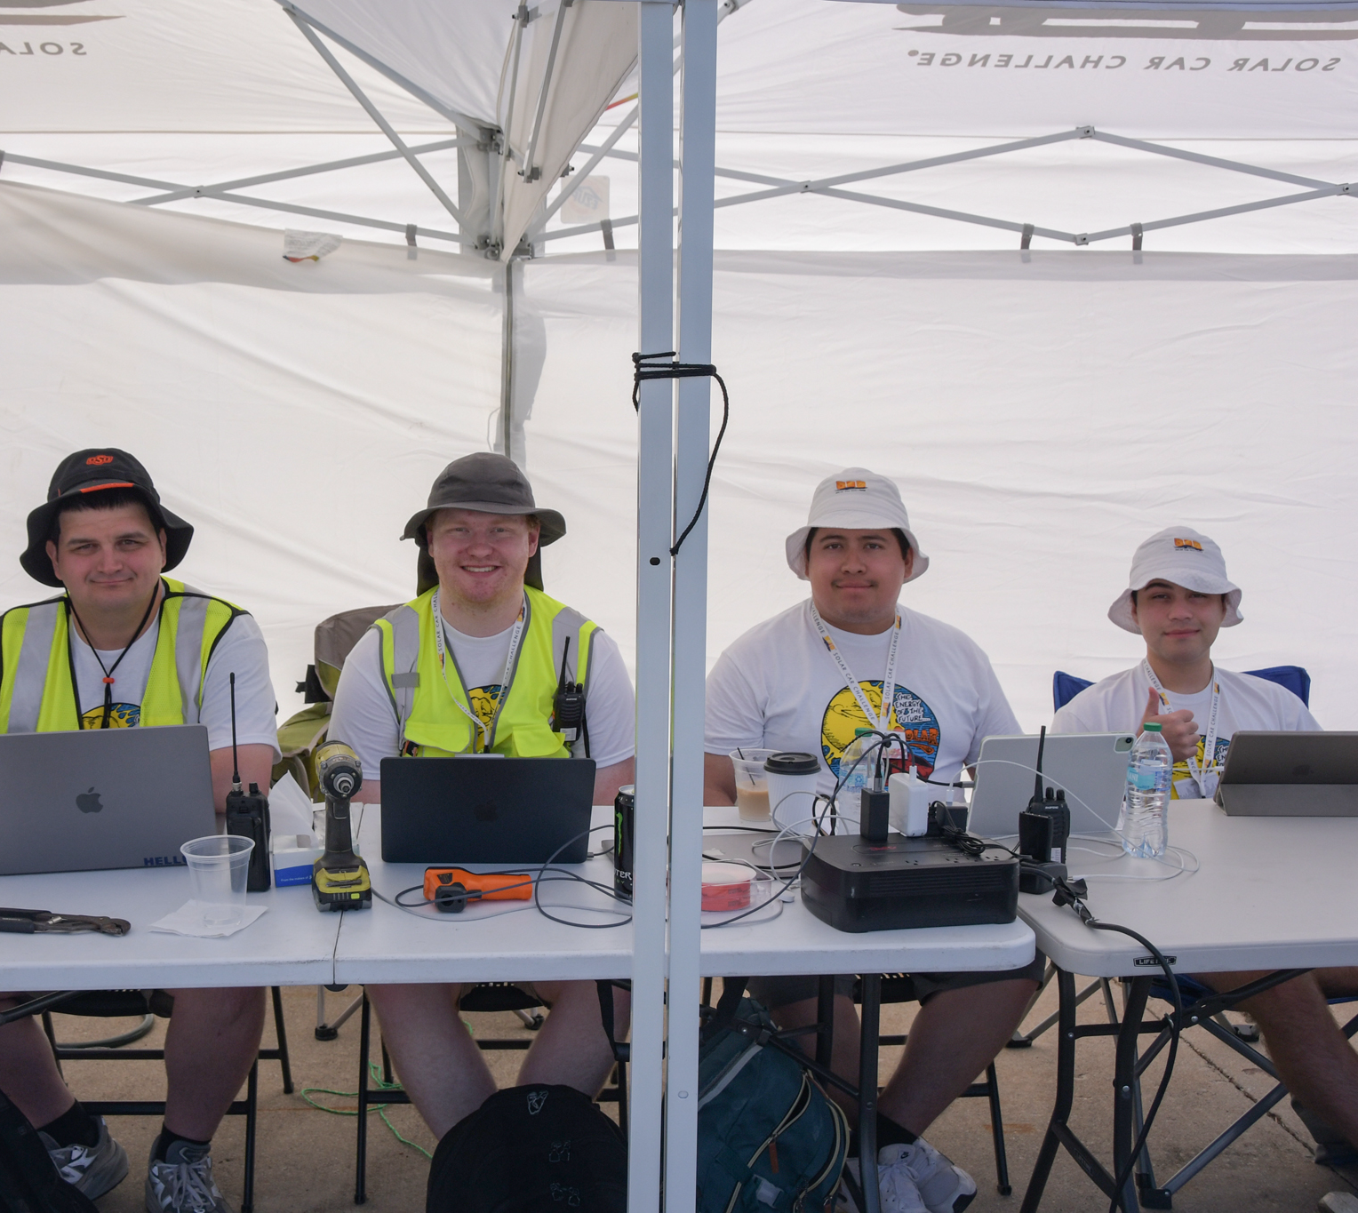
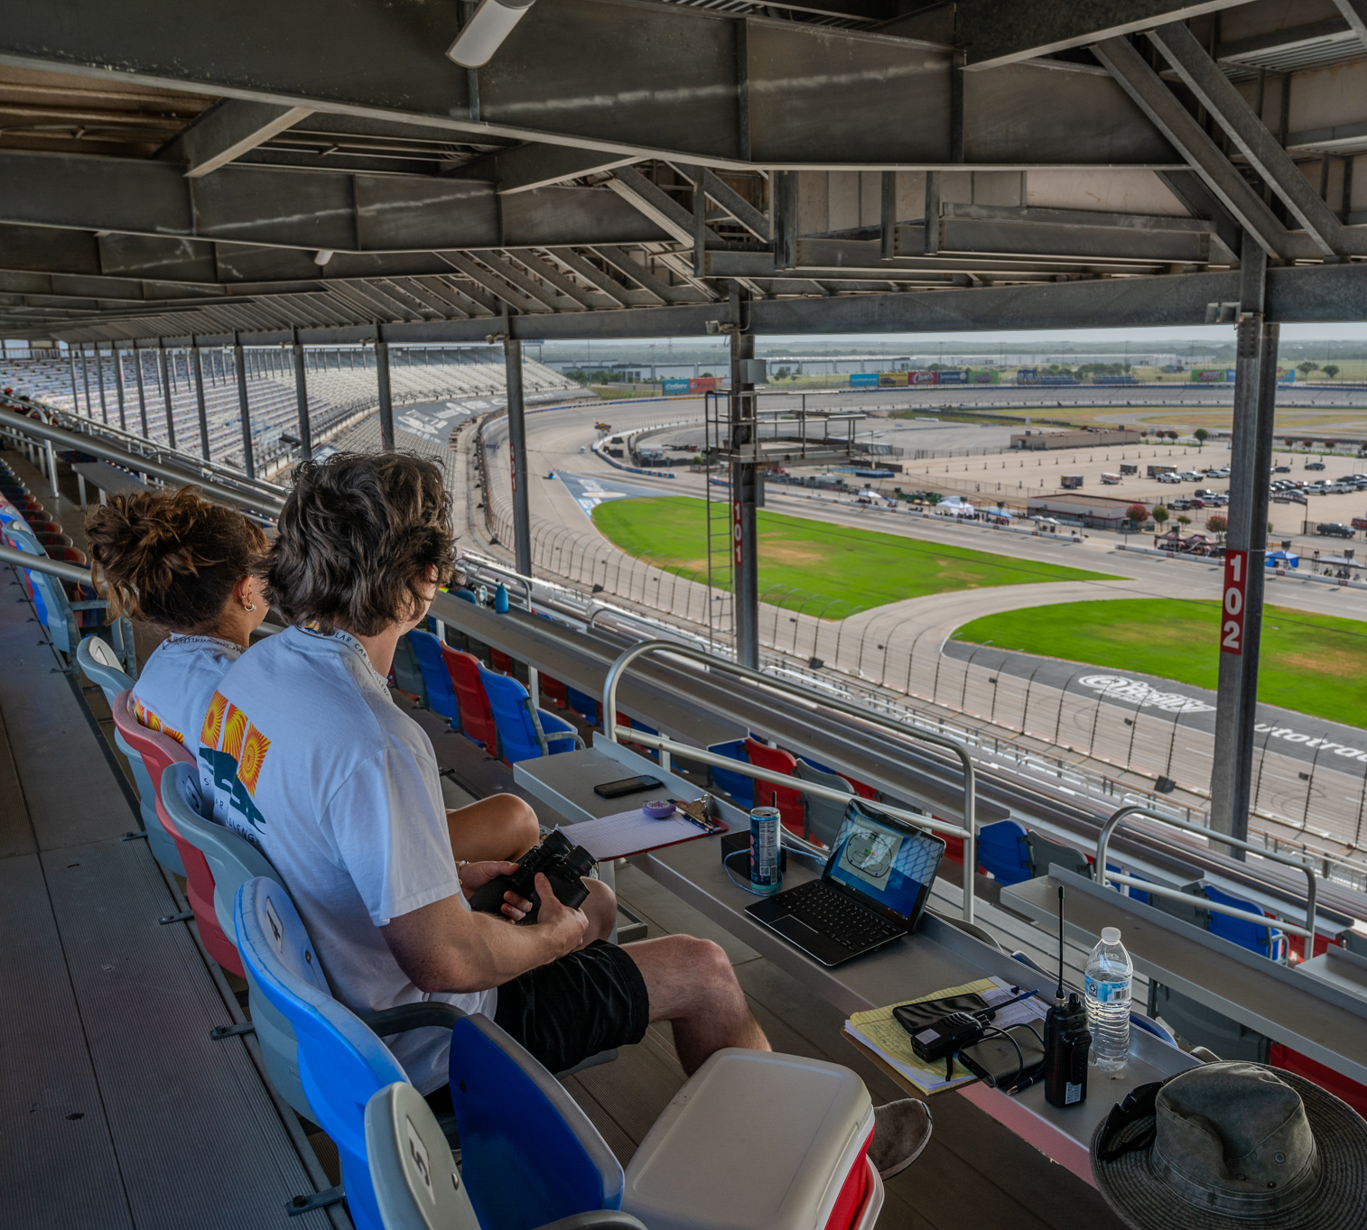
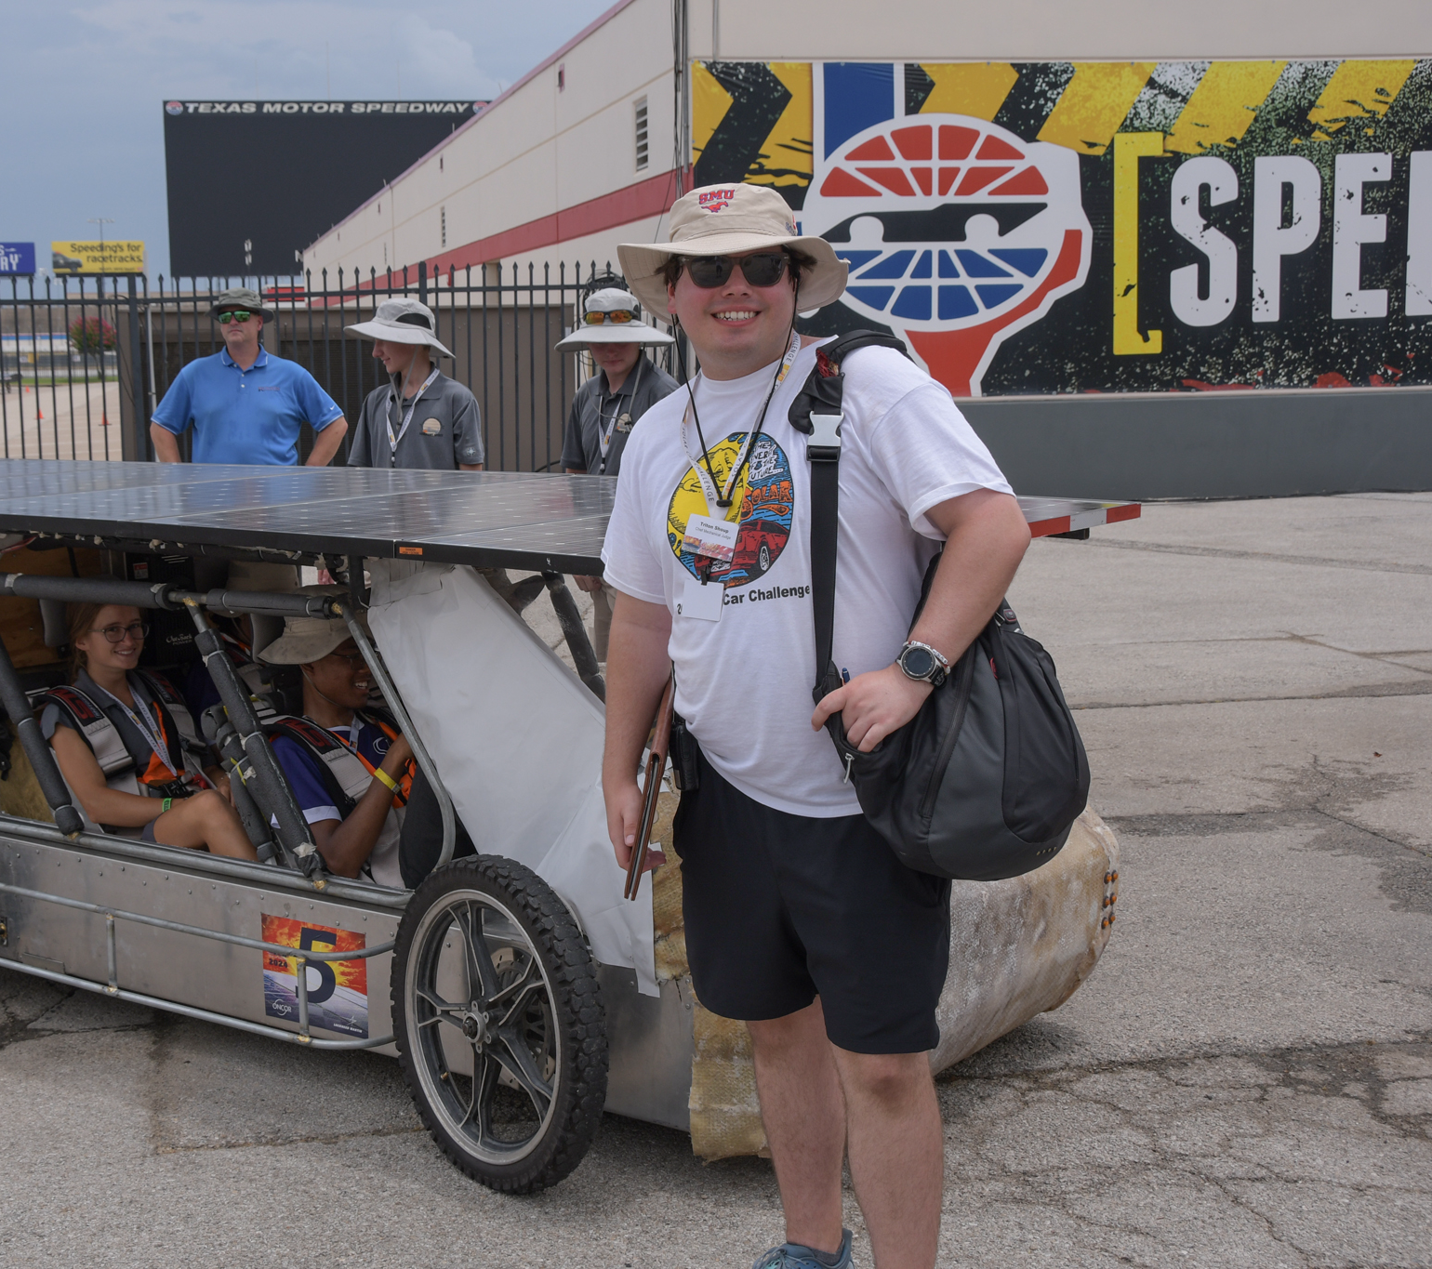
What a Solar Car Challenge Intern Entails
Set up
  Setting up for registration
  Judges training
  Track set up
  Scrutineering set up
Scrutineering
Lead scrutineering judges
Judging Teams
Spotting
Race Control operation
  Lap counter
  Controller

Slide 6
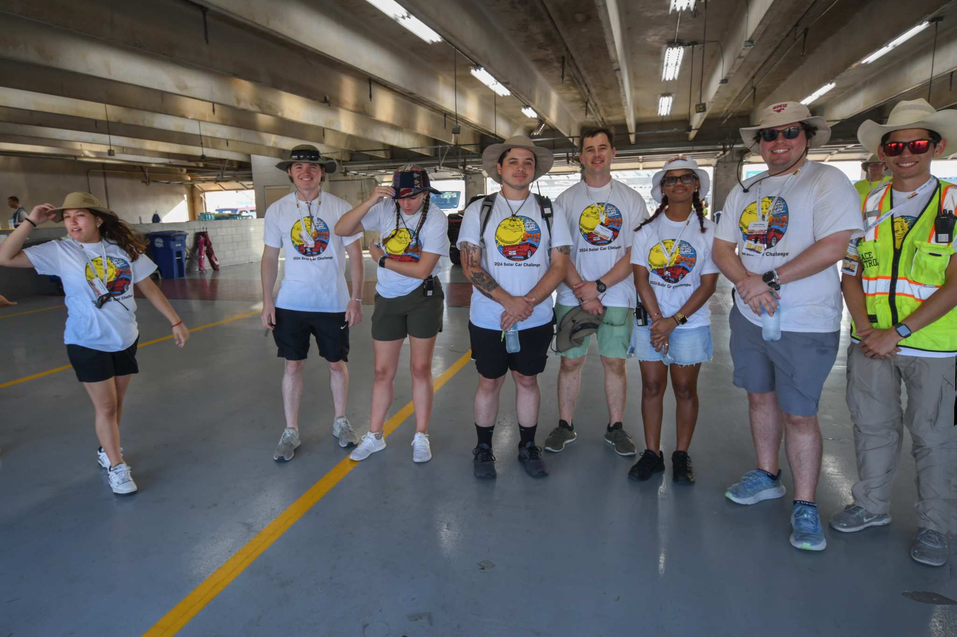
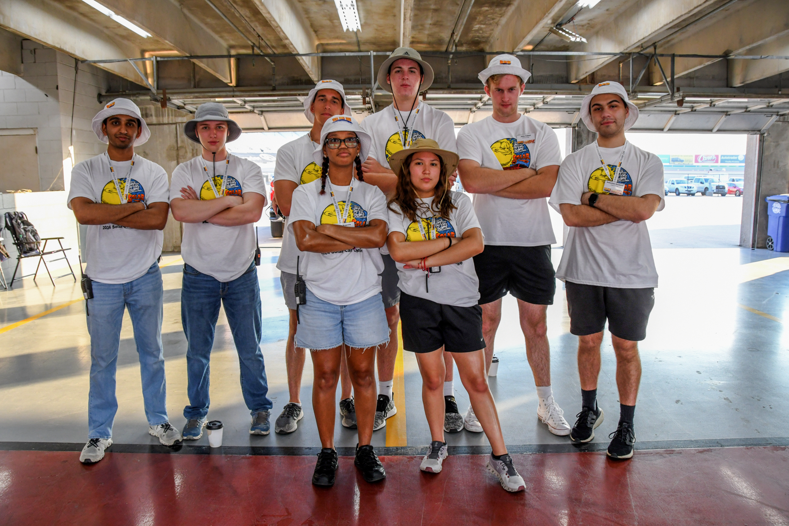
Why do it
Great experience and memories – allows you to get the annual solar “bug” out of your system… still livin’ the dream!
Very positive and collaborative environment between staff, judges, and interns
You are allowed to voice your opinions on rules and make changes in the organization. You are not solely there to be the “to-do” person
Great recommendation opportunity from Dr. Marks - or any race staff you have direct interaction with (for applications, internships, and scholarships)
Leadership opportunity in a recognized organization associated with giants in the engineering world and beyond

Slide 7
Thank You
Any Questions?

